Slide 1
Learning from Examples
Niranjan Balasubramanian
Fall 2017 CS 537
Credits:
AIMA Book
Slides on Naïve Bayes from:
Dan Klein and Pieter Abbeel.

Slide 2
Outline for this week
Introduction
Naïve Bayes Classification
Logistic Regression

Slide 3
Concepts to learn
What do we mean by learning?
What is the basic supervised learning recipe?
Generative vs. Discriminative Modeling
Overfitting, Underfitting, and Regularization

Slide 4
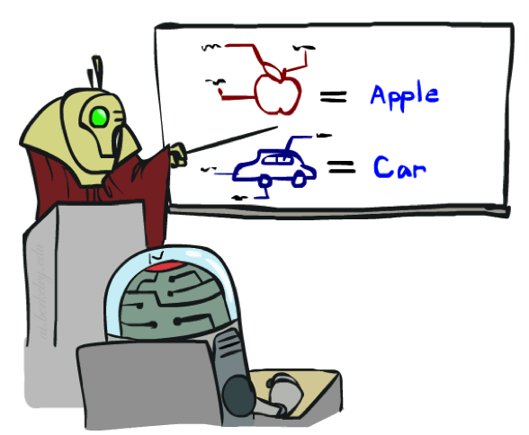
Introduction – Learning from examples
In many situations it is hard to clearly specify how to behave.
But we could easily say provide examples on how to behave!
In these scenarios we want to build an agent that learns how to act.
At least learns to

Slide 5
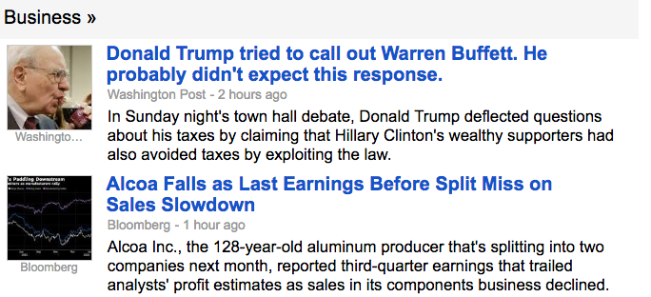
Introduction – Learning from examples
Machine learning is a field devoted to this subject.
Remarkable progress and is invaluable in today’s society.
Many varieties of algorithms exist.
Empirical results are much more exciting than the theoretical gloom ☹
Large data and cheap compute has lead to fantastic applications.

Slide 6
Types of learning
Supervised
When you have
Unsupervised
When you don’t have
Semi-supervised
When you have
Reinforcement Learning
When you have

Slide 7
Types of outputs
Discrete labels
Binary
Multi-class
Continuous values
Real valued outputs
Unlabeled clusters
Structured outputs
Chains
Graph structured outputs
Natural language
Painting
Control and Behaviors
Driving
Robotic arm control

Slide 8
Supervised Learning: A general recipe!
Test Data
Labeled Data
Training
Model
Predictions

Slide 9
Learning to Predict
Features
Classifier, a function over the features
Object
Two main questions in ML:
1) How do we get features?
2) How do we obtain the classifier function?

Slide 10
General Naïve Bayes Model
Suppose you want to predict if an email is spam or ham.
Dear Sir.
First, I must solicit your confidence in this transaction, this is by virture of its nature as being utterly confidencial and top secret. …
TO BE REMOVED FROM FUTURE MAILINGS, SIMPLY REPLY TO THIS MESSAGE AND PUT "REMOVE" IN THE SUBJECT.
99 MILLION EMAIL ADDRESSES
FOR ONLY $99
Ok, Iknow this is blatantly OT but I'm beginning to go insane. Had an old Dell Dimension XPS sitting in the corner and decided to put it to use, I know it was working pre being stuck in the corner, but when I plugged it in, hit the power nothing happened.

Slide 11
General Naïve Bayes Model
> Suppose you want to predict if an email is spam or ham.
> What are your outputs?
Y = { }
What are your features?
1.
2.
3.
4.
Let’s denote these by random variables F_{i.}
Dear Sir.
First, I must solicit your confidence in this transaction, this is by virture of its nature as being utterly confidencial and top secret. …
TO BE REMOVED FROM FUTURE MAILINGS, SIMPLY REPLY TO THIS MESSAGE AND PUT "REMOVE" IN THE SUBJECT.
99 MILLION EMAIL ADDRESSES
FOR ONLY $99
Ok, Iknow this is blatantly OT but I'm beginning to go insane. Had an old Dell Dimension XPS sitting in the corner and decided to put it to use, I know it was working pre being stuck in the corner, but when I plugged it in, hit the power nothing happened.

Slide 12


Naïve Bayes is a Bayesian Network!
Assume all features are independent effects of label.
We only have to specify how each feature depends on the class
What are the CPTs associated with this network?
Y
F₁
F₂
F_{n}

Slide 13
Naïve Bayes is a Bayesian Network!
What probability do we want for classification?
How to get the conditional from the joint for this network? Inference!
Y
F₁
F₂
F_{n}

Slide 14
Naïve Bayes is a Bayesian Network!
How do we get the conditional probabilities? Estimate from training data.
Y
F₁
F₂
F_{n}

Slide 15
An example: Bag-of-words Naïve Bayes
Data:
Collection of emails, labeled spam or ham
Note: someone has to hand label all this data!
Split into training, held-out, test sets
Features
Words that occur in the document.
Classifier
Bayesian Network
Label conditioned on feature variables (spam vs. ham)
Assume features are conditionally independent given class label
Dear Sir.
First, I must solicit your confidence in this transaction, this is by virture of its nature as being utterly confidencial and top secret. …
TO BE REMOVED FROM FUTURE MAILINGS, SIMPLY REPLY TO THIS MESSAGE AND PUT "REMOVE" IN THE SUBJECT.
99 MILLION EMAIL ADDRESSES
FOR ONLY $99
Ok, Iknow this is blatantly OT but I'm beginning to go insane. Had an old Dell Dimension XPS sitting in the corner and decided to put it to use, I know it was working pre being stuck in the corner, but when I plugged it in, hit the power nothing happened.

Slide 16
An example: Bag-of-words Naïve Bayes
BN Variables?
BN CPTs?
Y
W₁
W₂
W_{n}

Slide 17
An example: Bag-of-words Naïve Bayes
BN Variables
Y = {Spam, Ham}, the label variable
W_{i} = word in position i.
E.g. Nigerian Prince wants to …
W₁ = Nigerian
W₂ = Prince
W₃ = wants
W₄ = to
Each W_{i} = {a, an, the, …., zebra}
Y
W₁
W₂
W_{n}

Slide 18
An example: Bag-of-words Naïve Bayes
Joint Distribution?
What do we want for prediction?
Use Bayes Rule
Y
W₁
W₂
W_{n}

Slide 19
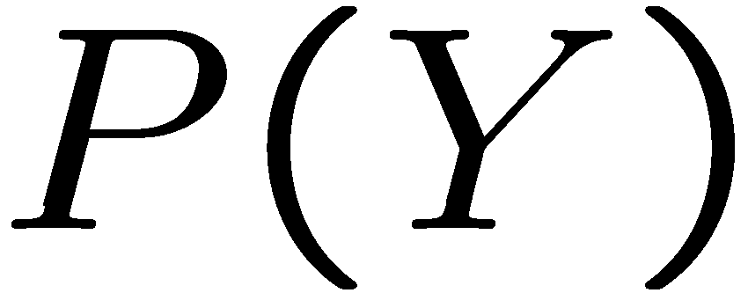
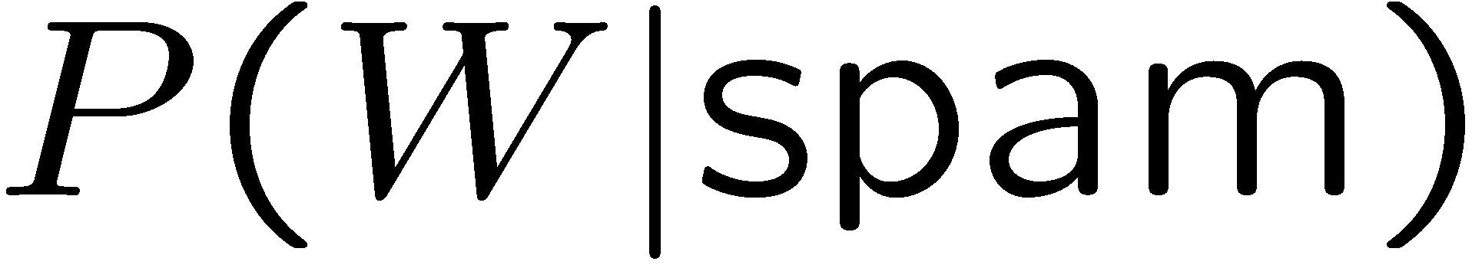
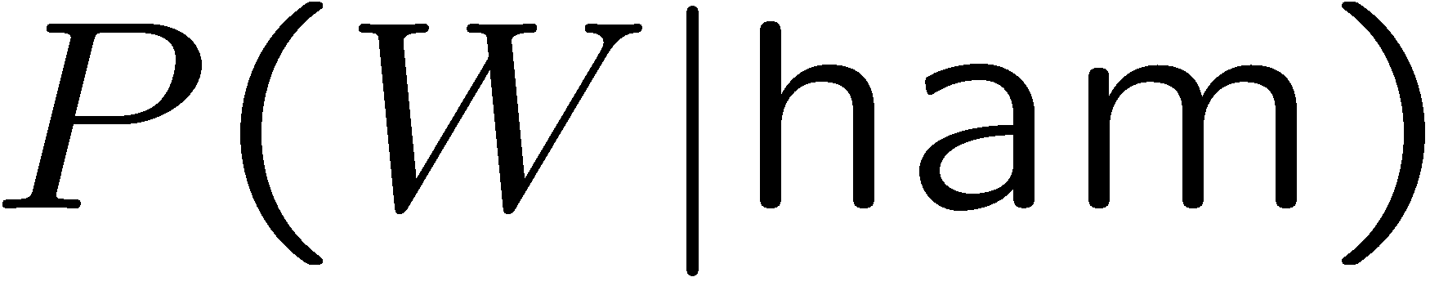
An example: Bag-of-words Naïve Bayes
We want:
Note we don’t need a separate CPT for each word position.
Assumption in the model!
Y
W₁
W₂
W_{n}

Slide 20
An example: Bag-of-words Naïve Bayes
Use training data to estimate!
Maximum likelihood estimation
Max a posteriori estimation
Y
W₁
W₂
W_{n}

Slide 21


How do we know our classifier is any good?
Experimental Cycle
Evaluation Metrics:
Accuracy
Precision
Recall
F-measure
Training
Data
Held-Out
Data
Test
Data

Slide 22
Issues: Independence assumptions
Need more features– words aren’t enough!
Can add these information sources as new variables in the NB model
But
Example:
“New” and “York”
Knowing “York” tells me
If you use P(“New”|C) and P(“York”|C)
There are classifiers which let you easily add arbitrary features more easily.
We’ll see one such next.

Slide 23
Issues: Independence assumptions
Need more features– words aren’t enough!
Have other people just gotten the same email?
Is the email in ALL CAPS?
Do inline URLs point where they say they point?
Can add these information sources as new variables in the NB model
But will be violating independence assumptions even more.
Example:
“New” and “York” are dependent even when the class is observed.
Knowing “York” tells me New is likely to be present in the email.
If you P(“New”|C) and P(“York”|C) both contribute independent evidence.
There are classifiers which let you easily add arbitrary features more easily.
We’ll see one such next.

Slide 24

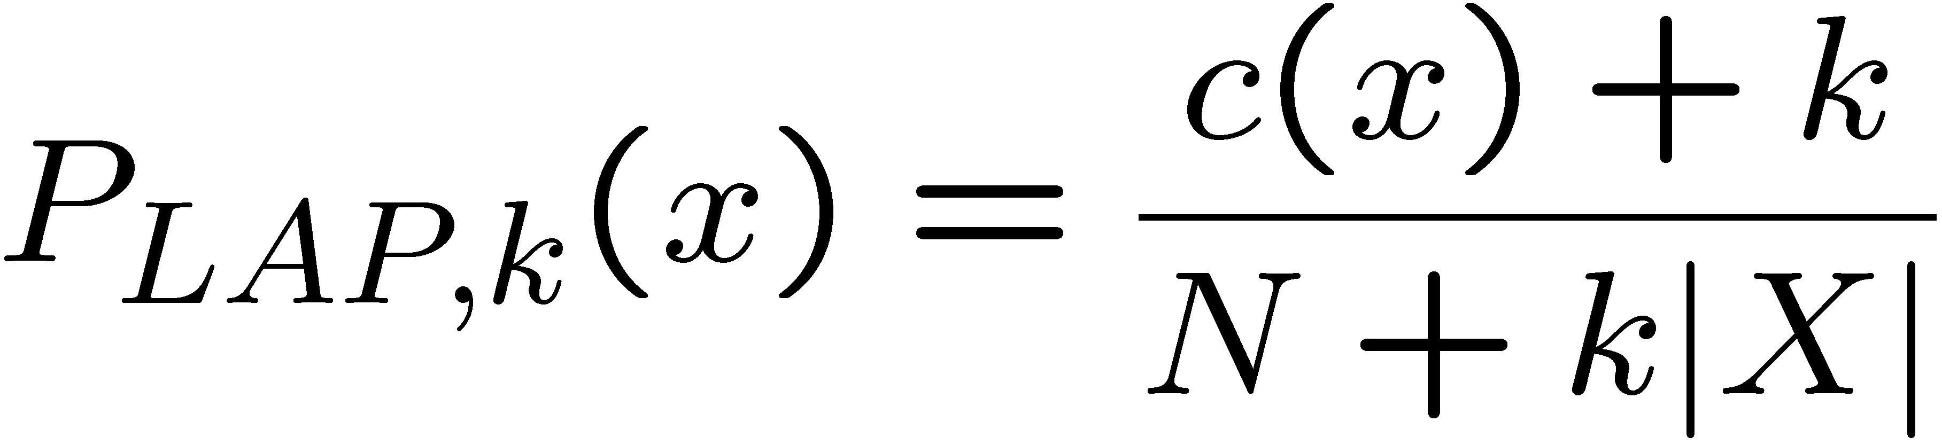



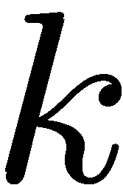
Issues: Generalization and Overfitting
Overfitting
As an extreme case with no generalization!
Just making the bag-of-words assumption gives us some generalization, but isn’t enough
To generalize better: we need to smooth or regularize the estimates
Laplace’s estimate: Pretend you saw every outcome k extra times
What’s Laplace with k = 0?
Two kinds of unknowns, parameters and hyperparameters.
Estimate probabilities from training data.
Choose k based on held-out performance.

Slide 25
Issues: Generalization and Overfitting
Relative frequency parameters will overfit the training data!
Unlikely that every occurrence of “minute” is 100% spam
Unlikely that every occurrence of “seriously” is 100% ham
What about all the words that don’t occur in the training set at all?
In general, we can’t go around giving unseen events zero probability
As an extreme case, imagine using the entire email as the only feature
Would get the training data perfect (if deterministic labeling)
Wouldn’t generalize at all
Just making the bag-of-words assumption gives us some generalization, but isn’t enough
To generalize better: we need to smooth or regularize the estimates
Laplace’s estimate
Pretend you saw every outcome k extra times
What’s Laplace with k = 0?
k is the strength of the prior
Two kinds of unknowns, parameters and hyperparameters.
Estimate probabilities from training data.
Choose k based on held-out performance.

Slide 26
Discriminative Classification
Bayesian networks are generative models
They model the joint distribution of the instances and the labels.
Why model joint P(Y, X)?
After all we only care about P( | )
We are interested in selecting the best Y given the evidence X i.e, P(Y|X)
Models that directly estimate this are called discriminative classifiers!

Slide 27
Discriminative Classification = Conditional Probability Estimation
Let’s learn a function that can predict P(Y|X) directly!
Assume that P(Y|X) is a parameterized function of some form.
Find the “best” values for these parameters using the training data.
Logistic regression is one example.

Slide 28
Logistic Regression Recipe: For binary classification
Assume that there is a function that approximates P(Y|X)
We will jump a couple of steps to arrive at this form.
First, what constraints should this function satisfy?

Slide 29
Logistic Regression Recipe: For binary classification
Let’s consider a linear combination function.
Something that simply does a weighted combination of the feature values.
Does this form satisfy our constraints?
What is the fix?

Slide 30
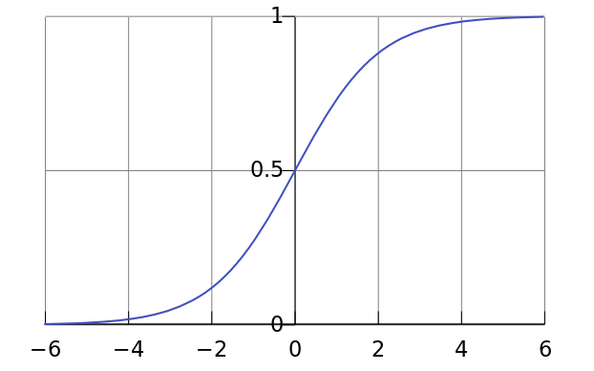
Logistic Regression Recipe: For binary classification
Let’s consider a linear combination function.
Something that simply does a weighted combination of the feature values.
Does this form satisfy our constraints?
Is ?
What is the fix?

Slide 31
Learning Parameters
Parameterized function that approximates P(Y|X)
There are many, many parameter settings that satisfy the constraints.
Which one should we select?

Slide 32
Training: Setting an objective function
Select a set of parameters that minimize the errors on the training set.
or equivalently,
Select a set of parameters that maximize the probability of the training data.

Slide 33
Training: Setting an objective function
Select a set of parameters that maximize the probability of the training data.
Probability of the training data
Find argmax to give the best parameter settings.

Slide 34
Training: Setting an objective function
Select a set of parameters that maximize the probability of the training data.
Probability of the training data: Likelihood of data!
Find argmax to give the best parameter settings.

Slide 35
Optimization: Finding the max (or min) of a function
How to find the max of our objective?
How do you find the max of a function f(x)?

Slide 36
Optimization: Finding the max (or min) of a function
Let’s compute the derivative of our objective and see if we can solve for W.
Let’s make our lives simpler by using a log-likelihood objective instead of likelihood.
Taking log leaves the argmax unchanged.
Rewrite the summation to separate cases w/ Y^{l} = 1 and Y^{l} = 0
Rearrange the terms to collect y_{c} terms in one place

Slide 37
Optimization: Finding the max (or min) of a function
Let’s compute the derivative of our objective and see if we can solve for W.
Let’s make our lives simpler by using a log-likelihood objective instead of likelihood.
Taking log leaves the argmax unchanged.
Rewrite the summation to separate cases w/ Y^{l} = 1 and Y^{l} = 0
Rearrange the terms to collect y_{c} terms in one place

Slide 38
Optimization: Find the max of the log-likelihood function.
Doing a bit of arithmetic will get you
Substituting back
Using ln(1/a) = - ln (a) ➔

Slide 39
Optimization: Find the max of the log-likelihood function.
Doing a bit of arithmetic will get you
Substituting back
Using ln(1/a) = - ln (a) ➔

Slide 40
Optimization: Find the max of the log-likelihood function.
Let’s take the gradient of this function w.r.t to W and set it to zero and solve for W.
The gradient is the set of partial derivatives w.r.t each W_{i}
Set this to zero. Can you solve for W_{i}?

Slide 41
Optimization: Find the max of the log-likelihood function.
Let’s take the gradient of this function w.r.t to W
This is the set of partial derivatives w.r.t each W_{i}
Where,
You can set this to zero but you cannot solve for W_{i} because of the non-linearity!

Slide 42
Not to worry! Gradient Descent (Ascent) will save us.
Numerical method for the finding the maximum (and the arg-max).
Idea:
Start with W ← <0, 0, …, 0>
Find an update to W that will increase L(W)
Iterate until some stopping criterion is met.
Under some conditions this procedure will find the maximum
Intuition:
Gradient of a function at any point = slope of tangent plane at the point
The slope provides the direction in which the function increases most
Take a small step in the gradient direction.

Slide 43
Not to worry! Gradient Descent (Ascent) will save us.
Gradient Ascent Intuition:
Gradient of a function at any point = slope of tangent plane at the point
- The slope provides the direction in which the function increases the most.
- Take a small step in the gradient direction.

Slide 44
Not to worry! Gradient Descent (Ascent) will save us.
Gradient Ascent Intuition:
Gradient of a function at any point = slope of tangent plane at the point
- The slope provides the direction in which the function increases the most.
- Take a small step along the gradient direction at the point.
y = f’(x) + c
f(x)
x⁰
x¹
f’(x⁰) is the slope of the tangent at x⁰ to f(x).
If it is positive it tells us increasing x will increase value of f(x).

Slide 45
Gradient Ascent: Update rule
Rule
Recall the partial derivative is:
Two things to note:
Current estimate
Error term
Update rule per W_{i} :

Slide 46
Gradient Ascent: Update rule
where,
Current estimate!
Error term!

Slide 47
Gradient Ascent: Termination, Convergence, and Alternatives
1) When to stop updating?
2) Convergence Guarantee
3) Alternatives

Slide 48
Gradient Ascent
When to stop updating?
Stop when W doesn’t change anymore.
For a fixed step size, W will eventually converge. (Why?)
Convergence Guarantee
If L(W) is concave (which it is here), GA will converge to global maximum.
Alternatives
BFGS (Weka) and L-BFGS
Use L(W) and its gradient as sub-routines

Slide 49
Overfitting and Regularization
Over-fitting: As you add more features i.e., parameters to your model
The complexity of the model increases.
The error decreases in training because you have more freedom to fit function.
At the same time you might be over fitting to some noise
This means your performance on unseen examples will suffer.
Error
Model complexity

Slide 50
Regularization
Over-fitting
Training error decreases but not test error!
Error
Test/Validation
Training
Model complexity

Slide 51
Regularization
> Issue Over fitting results in large W values.
> Fix?
> Update rule with regularization

Slide 52
Regularization
Over fitting results in large W values.
Regularization aims to enforce sparsity. i.e., small W
Add a penalty term to the Log-likelihood function
Update rule with regularization parameter

Slide 53
Extending Logistic Regression to Multiple Classes

Slide 54
Logistic Regression Summary
Discriminative version of Naïve Bayes
Models the class conditional directly.
Often the first choice when the feature set is not too large.
Especially for binary classification.
Easily extends to multiple classes
Maximum entropy classifier
Useful references
Generative and Discriminative Classifiers (Chapter 1), Machine Learning, Tom Mitchell.
On Discriminative vs. Generative Classifiers: A comparison of Logistic Regression and Naïve Bayes, Ng and Jordan, NIPS 2002.
Andrew Ng’s Coursera Lectures on Logistic Regression
https://class.coursera.org/ml-003/lecture

Slide 55
Learning Methods
https://www.kaggle.com/surveys/2017

Slide 56
Machine Learning: Big picture thoughts.
We have excellent approaches for what to do when we have labeled examples.
We can do simple classification to more difficult structure predictions.
We still do much of the work, feature engineering, setting up objective functions.
Our learning is not robust. Easily fooled by adversarial examples.
Deep learning aims to get models to figure out the features on their own.
We still do much of the work, but now in engineering the architecture.
Unsupervised learning aims to get rid of labels
We have very little success in this space.
Humans generalize from few examples very quickly.
One-shot and zero-shot learning are in infancy.
Our learning for one problem doesn’t easily translate to other tasks.
We have some idea for how to transfer to other domains but same task.
Interactive/immersive learning is going to be key in next steps.

Slide 57
Stop here.

Slide 58
Logistic Regression
Find a function h that approximates P(Y|X) directly.
i.e., we want a h such that:
If Y is binary, we have
h is constrained:

Slide 59
Logistic Function
The logistic function meets the range constraint.

Slide 60
Logistic Function
Typically, X is a n-dimensional feature vector.
We set h to be the logistic function
-- Over a linear combination of X parameterized by W.
where,
To fully specify h we only need to specify W.

Slide 61
Classifier
Assume that we have chosen a particular W.
We can use the following rule to classify a new instance X:
Using h the classification rule becomes
Or,

Slide 62
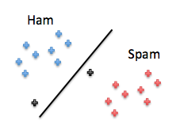
Learning: What W to use?
Idea:
Find a W such that P(Y|X;W) agrees with the training data.
For each instance X^{l} in the training data:
P(Y^{l} = 1 | X^{l}; W) → 1 if instance X^{l} belongs to class 1.
P(Y^{l} = 1 | X^{l}; W) → 0 otherwise.
i.e., Find W that maximizes data likelihood.
Alternate formulation:
Minimize errors on the training data.

Slide 63
Log-likelihood of Data
Taking natural log leaves the argmax unchanged
Equivalent re-write
Re-arranging terms

Slide 64
Log-likelihood of Data
After some arithmetic,
Substituting
ln (1/a) = - ln (a)

Slide 65
Log-likelihood of Data
No closed form solution because of the non-linearity.
i.e. setting to zero and solving for variables doesn’t work.

Slide 66
Gradient Ascent
Numerical method for the finding the maximum (and the arg-max).
Idea:
Start with W <- <0, 0, …, 0>
Find an update to W that will increase L(W)
Iterate until some stopping criterion is met.
Under some conditions this procedure will find the maximum
Intuition:
Gradient of a function at a point = slope of tangent plane at the point
The slope provides the direction in which the function increases most
Take a small step in the gradient direction.

Slide 67
Gradient Ascent
Numerical method for the finding the maximum (and the arg-max).
Idea:
Start with W <- <0, 0, …, 0>
Find an update to W that will increase L(W)
Iterate until some stopping criterion is met.
Under some conditions this procedure will find the maximum
Update Rule:
where,
- step size

Slide 68
Gradient
Compute partial derivatives
Current estimate!
Error term!

Slide 69
Update Rule
Update all elements of weight vector based on error.
Termination criteria
Stop when W doesn’t change anymore.
For a fixed step size, W will eventually converge. (Why?)
Convergence Guarantee
If L(W) is concave (which it is here), GA will converge to global maximum.
Alternatives
BFGS (Weka) and L-BFGS
Use L(W) and its gradient as sub-routines

Slide 70
ML Tricks + Pitfalls
Class Imbalance and Sampling
Feature Scaling and Normalization
Over-fitting and Regularization
L1 and L2 Norms
Linear vs. Non-linear Classifiers
Convergence Bounds

Slide 71
Regularization
Over-fitting
Training error decreases but not test error!
Error
Test/Validation
Training
Model complexity

Slide 72
Regularization
Over fitting results in large W values.
Regularization aims to enforce sparsity. i.e., small W
Add a penalty term to the Log-likelihood function
Update rule with regularization parameter

Slide 73
Extending Logistic Regression to Multiple Classes

Slide 74
Logistic Regression Summary
Discriminative version of Naïve Bayes
Models the class conditional directly.
Often the first choice when the feature set is not too large.
Especially for binary classification.
Easily extends to multiple classes
Maximum entropy classifier
Useful references
Generative and Discriminative Classifiers (Chapter 1), Machine Learning, Tom Mitchell.
On Discriminative vs. Generative Classifiers: A comparison of Logistic Regression and Naïve Bayes, Ng and Jordan, NIPS 2002.
Andrew Ng’s Coursera Lectures on Logistic Regression
https://class.coursera.org/ml-003/lecture

